Slide 1
Security On Touch!
Mentor: Mr. Abhay Kshirsagar (Etrx dept)
Team members: (Comp-A dept)
Jigar Dedhia.
Aakash Goplani.
Kirti Jaisinghani.

Slide 2
Contents:
1. Definition (Need for the device).
2. Review details.
3. System overview.
-Hardware.
-Software.
4. Applications.
5. Future Scope of the project.
6. References.

Slide 3

Why do we need this device?
Prototype of a Geo-location tracker.
Feel safe anywhere.
Explore the world without getting lost.

Slide 4
Do you feel safe in your city?

Slide 5
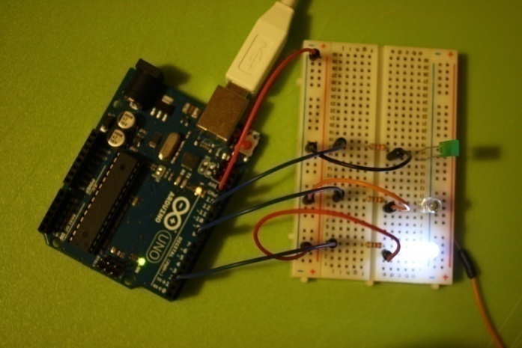

System overview
Hardware Specification
Software Specifications
Block Diagram.
Components.
Algorithm.
Platform.
Flow of the program.

Slide 6
HARDWARE
SPECIFICATION

Slide 7
HARDWARE USED:
MICROCONTROLLER – FREEDUINO
GSM MODULE –SIM900
GPS MODULE –S1315RL

Slide 8
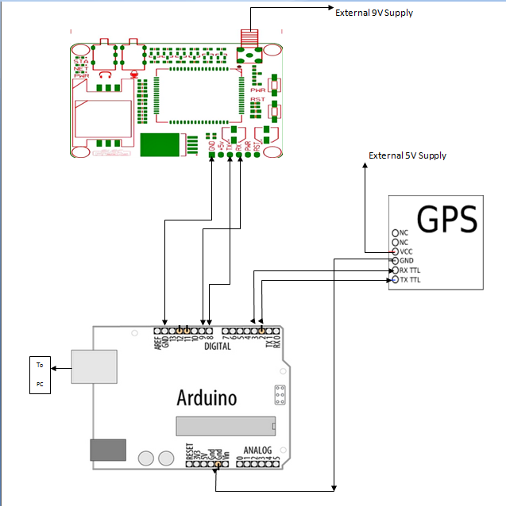
BLOCK DIAGRAM

Slide 9
MICROCONTROLLER(FREEDUINO)
Why Freeduino?
General Description.
Pin Specification.
Advantage of using Freeduino over other Arduino boards.

Slide 10
GSM MODULE(SIM900)
Why Sim900 GSM Module?
Module Overview.
Advantages.

Slide 11
GPS MODULE (S1315RL)
Why S1315RL GPS Module?
Technical Specifications.
Features.
Applications.

Slide 12
SOFTWARE
SPECIFICATIONS

Slide 13
ALGORITHM
Start : Button Press
Track current location using GPS device
Get longitude and latitude into a string
Pass it to the GSM device via controller
GSM sends a message to the entered number

Slide 14
PLATFORM USED.
Arduino platform
Arduino IDE
Programming similar to C or C++
Users only need define two functions to make a runnable cyclic executive program
setup()
loop()

Slide 15
FLOW OF THE PROGRAM
Track current Location
Pass on the co-ordinates as a String to the controller
Format the String message
Pass on to the GSM module
Connect to the network
Send the message to the number registered with the device
Start : Button Press
End

Slide 16
Where do we use it?
Collar belt of the pet.
Vehicle Tracking.
Security of important belongings if stolen
& many more.

Slide 17
FUTURE SCOPE
Integrating it in the police system.
As it is a prototype, making it into nano device.
Possible to store the gps data recorded.

Slide 18
REFERENCES
http://arduiniana.org/libraries/tinygps/
http://www.cooking-hacks.com/index.php/gps-module-for-arduino.html
http://learn.parallax.com/KickStart/28500/
A complete beginners guide to arduino by Mike McRoberts.

Slide 19
THANK YOU ☺

